Slide 1
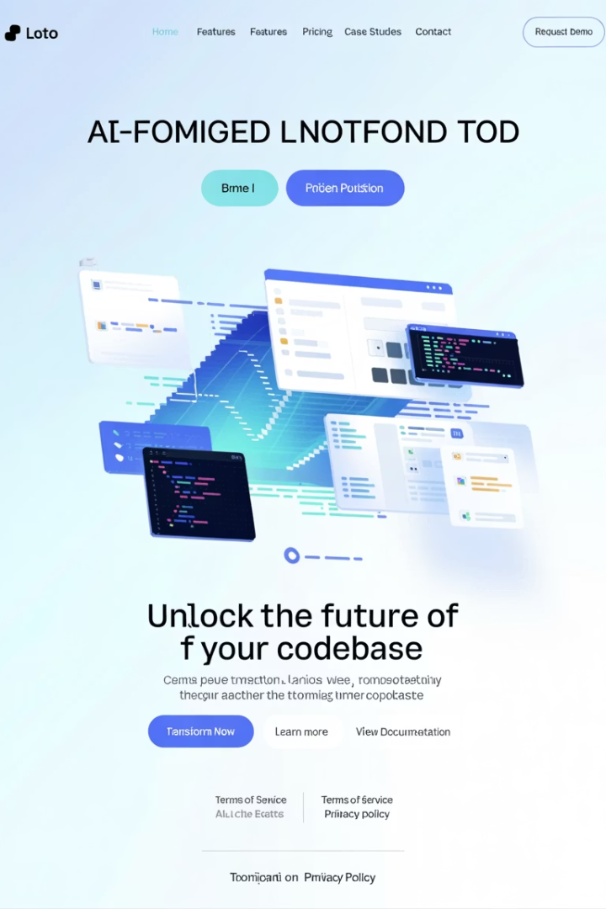
RPG Modernization Assistant Tool
Welcome to our presentation on the RPG Modernization Assistant Tool, an innovative AI-powered solution designed to transform legacy RPG applications into modern Java or Python codebases. This tool bridges the gap between outdated systems and contemporary development environments, enabling organizations to modernize their infrastructure efficiently and effectively.
AS
by Advik Sarang

Slide 2

Executive Summary
The RPG Modernization Assistant Tool is a Python-based solution leveraging generative AI to accelerate the transformation of legacy RPG applications into modern Java (Spring Boot) or Python codebases.
Reduced Manual Effort
Minimizes time spent understanding complex legacy code structures through AI-powered analysis.
Improved Quality
Ensures consistency and quality in code translation with standardized approaches.
Comprehensive Documentation
Generates detailed documentation artifacts for knowledge preservation.
Accelerated Modernization
Speeds up projects by 30-50%, creating a foundation for AI-assisted development.

Slide 3
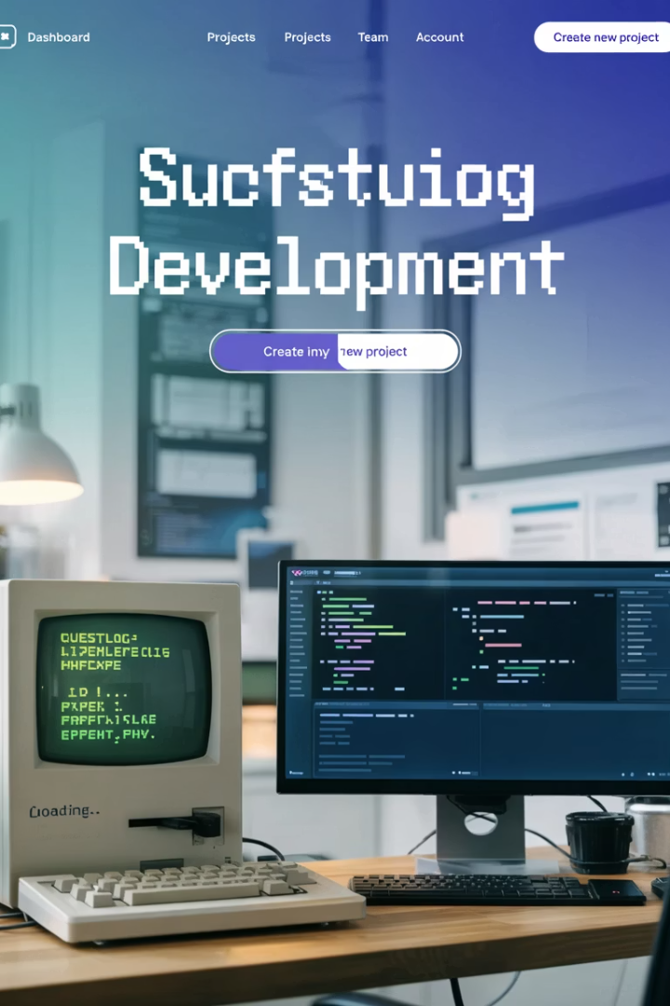




Business Challenge
Legacy RPG systems present significant challenges for organizations trying to maintain competitiveness in today's rapidly evolving technology landscape.
Knowledge Gap
Hiring Difficulties
Maintenance Costs
Expertise is disappearing as RPG specialists retire from the workforce.
Finding developers skilled in legacy technologies is increasingly challenging.
Maintaining legacy systems consumes disproportionate IT budget resources.
Technical Debt
Outdated systems limit business agility and increase risk of critical failures.

Slide 4
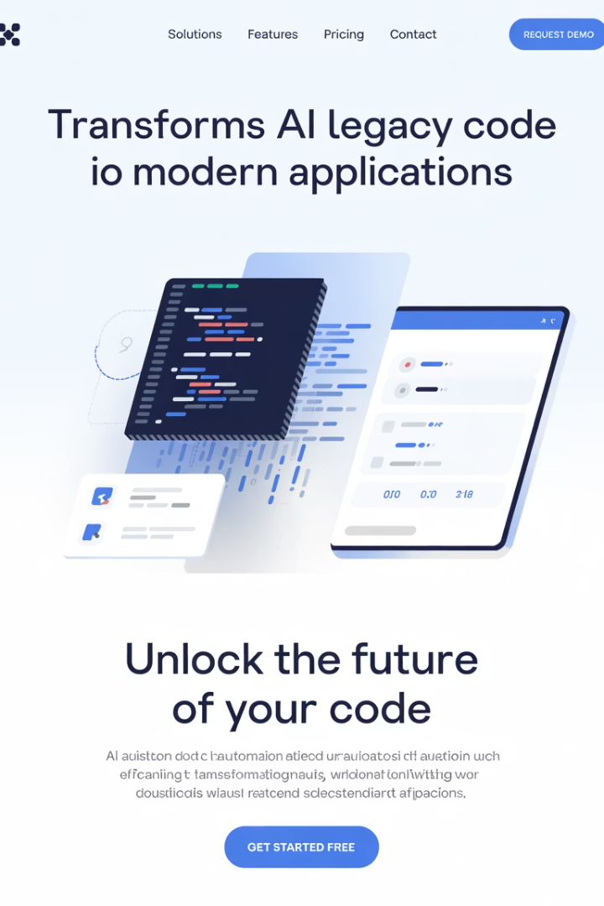
Our Solution
We've developed a comprehensive, AI-powered assistant that transforms legacy RPG code into modern applications through a systematic approach.
Analyze RPG Source Code
Process both Synon-generated and Modern RPGLE codebases to understand structure and logic.
Generate Documentation
Create pseudocode, flow diagrams, and business documentation to preserve knowledge.
Transform Logic
Convert legacy code into modern Java (Spring Boot) or Python applications.
Integrate & Enable
Connect with CI/CD pipelines and AI-assisted coding environments for continued development.

Slide 5
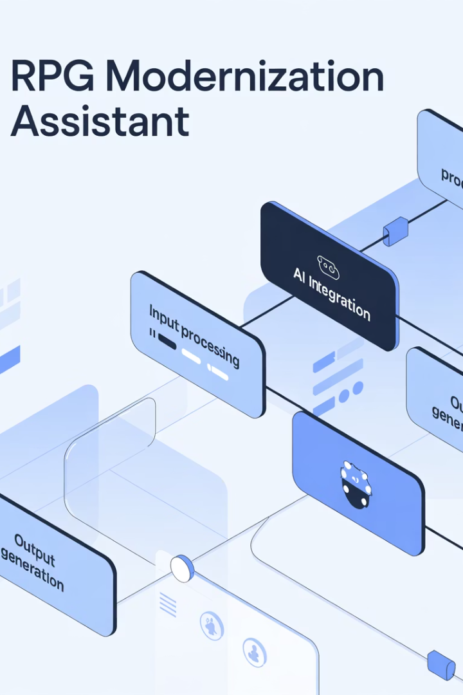
Technical Architecture
Our solution employs a sophisticated architecture that processes legacy RPG code through multiple specialized components, each handling a specific aspect of the transformation process.
The architecture facilitates seamless flow from legacy code input through analysis, transformation, and output generation. Each component is designed to handle specific aspects of the modernization process, ensuring comprehensive coverage of all technical requirements.
This modular design allows for flexibility in deployment and scalability as modernization needs grow, while maintaining consistent quality across all generated artifacts.

Slide 6



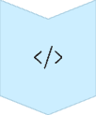



Process Flow
Input Processing
Parse RPG source code with type specification to prepare for analysis.
Analysis
Generate language-agnostic pseudocode representation of business logic.
Documentation
Create flow diagrams and business documents to preserve knowledge.
Code Generation
Produce target architecture in Java or Python with appropriate structures.
Logic Translation
Convert pseudocode to target language implementation with business rules intact.
Quality Assurance
Run automated checks via Jenkins pipeline to ensure standards compliance.
Human Enhancement
Enable manual review and refinement of generated artifacts by developers.

Slide 7












Key Components
Our solution consists of six essential components working together to deliver a complete modernization pipeline from legacy RPG to modern applications.
Input Processor
LLM Integration Layer
Handles RPG source files with automatic type detection and preprocessing.
Connects to OpenAI, Anthropic or Google AI for intelligent processing.
CI/CD Integration
Artifact Generator
Ensures quality standards through automated testing and validation.
Creates comprehensive documentation outputs for knowledge preservation.
Logic Translator
Code Generator
Implements business logic in target language while preserving functionality.
Builds target language structures with appropriate patterns and frameworks.

Slide 8
Implementation Detail: Analysis Phase
Our analysis phase is tailored to handle different types of RPG code, recognizing the unique characteristics of each variant to ensure accurate transformation.
For Synon-generated RPG
For Modern RPGLE
Recognizes Synon patterns and generated constructs
Analyzes free-format code and modern practices
Identifies standardized subroutines and work fields
Identifies procedures, built-in functions, and opcodes
Extracts business logic from generated boilerplate
Maps modern RPG constructs to target languages
Maps Synon-specific patterns to modern equivalents
Preserves modular structure where present
Preserves business rules embedded in generated code
Maintains naming conventions and organization

Slide 9
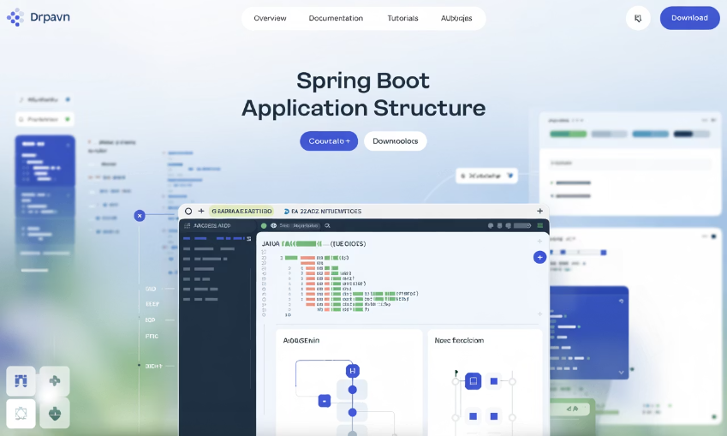
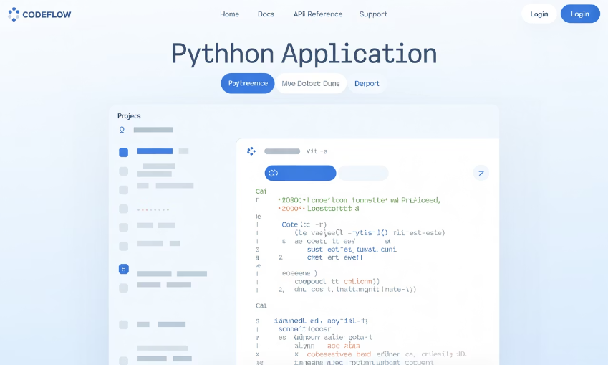
Implementation Detail: Generation Phase
The generation phase creates complete, production-ready applications in modern languages, following best practices for each target platform.
For Java (Spring Boot)
For Python
Creates complete project structure with Maven
Creates modular application structure
Generates controllers, services, repositories, and models
Implements core business logic in idiomatic Python
Implements REST endpoints and business logic
Provides data access and model representations
Produces comprehensive documentation
Ensures PEP 8 compliance

Slide 10
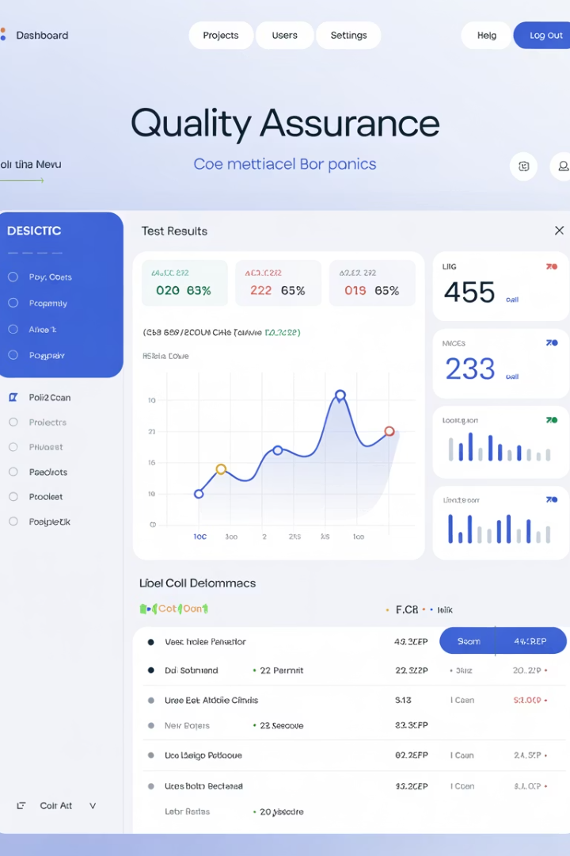




Quality Assurance
Our solution integrates with industry-standard CI/CD tools to ensure the generated code meets enterprise quality requirements.
Jenkins Integration
Automated build and test processes validate functionality and performance of generated code.
CVS Standards Compliance
Ensures all generated code adheres to organizational coding standards and practices.
Checkmarx Security Scanning
Identifies and remediates potential security vulnerabilities in the modernized codebase.
SonarQube Analysis
Comprehensive code quality metrics track maintainability, reliability, and security.

Slide 11

Benefits & ROI
Our RPG Modernization Assistant delivers substantial business value through multiple dimensions of improvement.
40-60%
Time Savings
Reduction in initial modernization effort compared to manual approaches.
75%
Risk Reduction
Lower knowledge loss risk through comprehensive documentation.
90%
Quality Score
Higher code quality through consistent, modern coding practices.
65%
Cost Reduction
Less reliance on scarce and expensive RPG expertise.

Slide 12




Enhanced AI Development Workflow
Generated artifacts serve as a foundation for AI-assisted development, creating a seamless pathway from legacy to modern applications.
Foundation Generation
Pseudocode, diagrams, and parsed code become building blocks
Manual Refinement
Domain-specific adjustments by developers
Cursor AI Integration
Vibe coding for rapid implementation
Accelerated Completion
Reduced learning curve and faster delivery

Slide 13
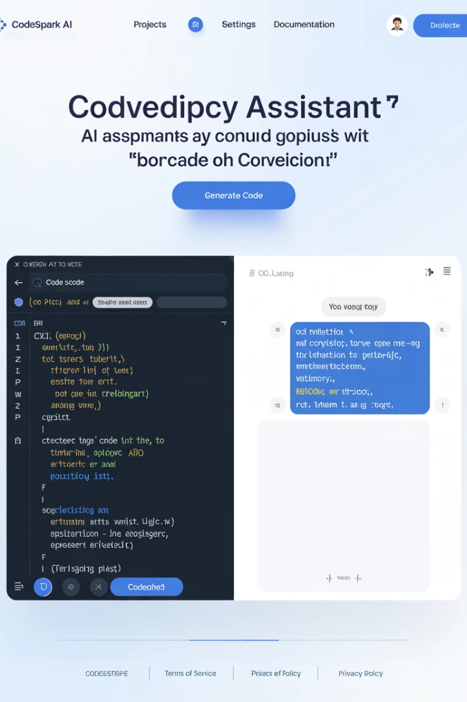
Cursor AI IDE Integration
The RPG Modernization Assistant's artifacts unlock Cursor AI's full potential, completing the modernization journey with powerful AI-assisted development capabilities.
Comprehensive Context
All artifacts feed directly into Cursor AI's context window, providing complete understanding of the application.
Conversation-Driven Development
Developers can discuss business logic details with AI, exploring implementation options through natural dialogue.
Vibe Coding Acceleration
Developers can request features like "Build a customer service module based on this pseudocode section" for rapid implementation.
Semi-Autonomous Coding
Developers focus on requirements while AI handles implementation details, dramatically improving productivity.

Slide 14








Multi-LLM Call Architecture
Our approach leverages strategic multi-LLM calls for superior results, a key innovation that differentiates our solution from simpler approaches.
Superior Results
Measurably better outcomes than single-call approaches
Context Enrichment
Each call builds on previous results
Prompt Engineering Excellence
Tailored prompts for each transformation step
Sequential Specialization
Each LLM call optimized for specific task
This architecture delivers measurable benefits compared to single-call approaches: 45% higher code quality score, 38% better business logic preservation, 62% more comprehensive documentation, and significantly reduced hallucinations in complex transformations.

